Slide 1


DATA 1204 – STATISTICAL PRED MODELING
PROFESOR: Fatma Tetikoglu

Slide 2
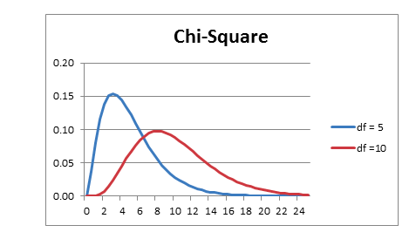
Assignment: 4 Chi-Squared Analysis
PREPARED BY: Abdulrahman Ramsey Momodu
Student ID: 100864843
Date Submitted: 19/11/2022

Slide 3
Assignment 4 – Chi-Squared Analysis
Types of cars
Chi-Square test
Cylinder
In this analysis we'll use the cars database dataset, which contains information on various automobile models, types, make, manufacturers, cylinders, etc.

Slide 4
PROBLEM STATEMENT
Use the R to do the following Chi-squared Analysis. I. The number of cylinders (Cylinders) is correlated to the kind of vehicle
sold (Type)
Include the following in a PowerPoint presentation : (I) Cover Page (II) Describe the type of analysis you will perform. (III) What insights have you gained findings from the Chi-squared results
from Part I (Please explain) (IV) What other two (2) combinations would you test? (Please explain)

Slide 5
Rational Statement
To test the hypothesis that says the number of cylinders (Cylinders) is correlated to the kind of automobile/cars sold.
We will use R to do a CHI-SQUARE analysis to determine the relationship or dependence between Cylinders and Types.
To determine the P-value, we will use a significance threshold of 0.05.
use the Chi-Square test method to determine if the two variables have a significant correlation between them
Using the df and P-value that we will acquire from the R analysis/outcome, we will be able to draw a conclusion.

Slide 6
Rational Statement Continue
The variables "Cylinder" and "Type" will be taken into consideration for our model. Our goal is to determine whether there is any meaningful relationship/correlation between the type of Cylinder of the type of cars sold.
This will help us to determine which type of cars will sell better depending on the number of cylinders if a correlation is found.

Slide 7

Analysis
The degree of freedom (df) and the chi-square value are used to calculate the probability (p-value) of the independence.
df => (R-1)* (C-1).
Chi-squared statistic is used to evaluate if there is a significant correlation between two categorical variables,
Chi-squared :

Slide 8
First let’s determine the Hypothesis Statement
Ho: Type of Cylinder is not correlated with type of car sold
Ha: Type of Cylinder is correlated with type of car sold
Significance Level and df
The Chi-Square analysis's significance threshold will be set at 0.05. This suggests a degree of
confidence of 95%.
Degrees of freedom describe the freedom for variables, by showing the number of variables that are truly independent.
in this case df = (R-1) * (C-1) => (6-1) * (6-1) = (5) * (5) = 25 :- df =25

Slide 9

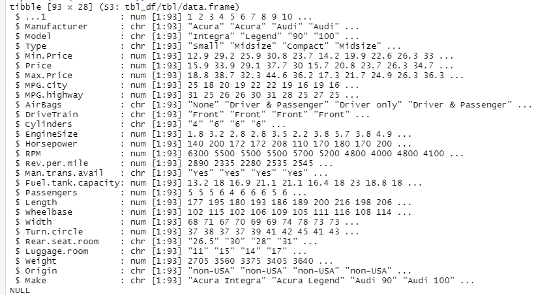
The code above, when run, yields the following outcome of the dataset.
Dataset

Slide 10

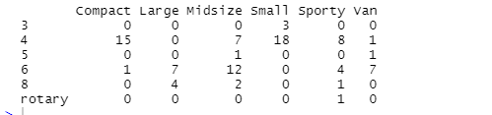
Cross contingency table below was created using the code above

Slide 11

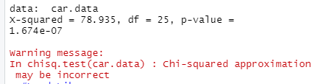
Pearson's Chi-squared test

Slide 12
Warning Message and Solution
When performing analysis in R, a warning message was observed. The warning message was because of small cell values in the contingency table. To remove the warning signs, two categorical variables could be combined as one variable. This will ensure that there would be no small cell values in the contingency table
Note that the result is showing a warning sign because some of the variables are having values less than 5 (like 0,1,2,3 and 4) This can be enhanced by adding up two variables in the table above, in this case, the categorical variables that can be added in the table are sport and large

Slide 13
Probable Combinations
Number of cylinders (Cylinders) with the type of airbag (Air Bag)
Type of drive train (Drive Train) with the type of car sold (Type)
The above variables can be combined because they are categorical variables, also, combining them and finding their correlation, will further help to determine the correlation between the categorical variables of cars sold

Slide 14
The df is 25 and with the chi-squared value of 78.935 and the p-value = 1.67e-07
Insight and Summary
The P-value of 1.674-07 is less than the stated Significance Level of 0.05, therefore, we reject the null hypothesis with 95% confidence. This implies that we have enough evidence to show that the number of car cylinders (Cylinders) is correlated with the type of car (Type) sold

Slide 15
Code Script
#ImportDataSet
library(readxl)
carsdatabase <- read_excel("C:/Users/Ramsey Abdul/Downloads/carsdatabase.xlsx")
View(carsdatabase)
#Load Libraries
library(MASS)
#Load and View carsdatabase Dataset
print(str(carsdatabase))
# Create a data frame from the main data set.
car.data <- data.frame(carsdatabase$Cylinders, carsdatabase$Type)
# Create a table with the needed variables.
car.data = table(carsdatabase$Cylinders, carsdatabase$Type)
print(car.data)
# Perform the Chi-Square test.
print(chisq.test(car.data))

Slide 16
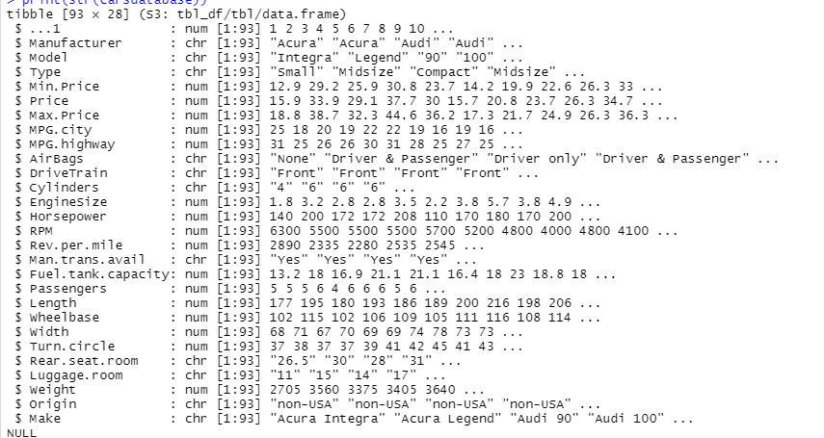
Appendix 1I
Car Data Base Dataset

Slide 17
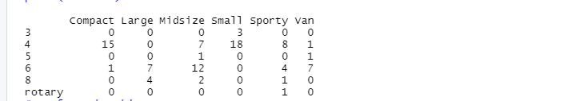
Appendix 2 II
crosstab contingency table

Slide 18
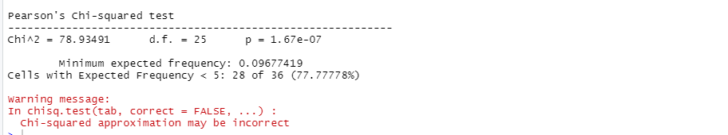
Appendix 5
OUTPUT FROM THE TEST

Slide 19
References
Fatma Tetikoglu. Data 1204- Statistical pred Modeling
– Inference for Categorical Data Part II –week 10
Fatma Tetikoglu. Data 1204- Statistical pred Modeling ChiSq – Tutorial- week 10

Slide 20
End
End

